Slide 1

Sheffield, Doncaster, Rotherham and North Lincolnshire
Transforming Care Partnership
Kelly Glover
Strategic Lead/Programme Director

Slide 2
What are we trying to achieve
In the broadest sense and what we are being measured on, is to discharge people from hospital and stop people going into hospital (LD/MH hospitals)
Improving quality of life
Improving quality of care
Reducing reliance on inpatient settings
Ensuring all people live a meaningful and fulfilled life Sounds easy, doesn’t it?

Slide 3
Why is it such a challenge?
Discharged the people who are easy to discharge
Too complex
Too risky
No Accommodation
No provider market
Workforce issues
No community infrastructure i.e. Enhanced Community Teams/Forensic Outreach
Too expensive
“We have never done it like this before”
“Well that’s the way we have always done it”
Notes:
These are the things I have heard and experienced from all the TCP’s I have worked in and I know these reasons will not be new to you in whichever area you work in. Some I agree with, some I do not.

Slide 4
Who should be involved?
People and their families
Commissioners – CCG/LA/NHS England
Hospital Providers
Care Providers
Housing Providers
Independent Clinical Advisors
Experts by Experience
We are all in it together!

Slide 5
When should we be doing it?
NOW!
Valuing people 2001
Valuing people now 2009
Mansell 2
Winterbourne View
The list goes on…..
Transforming Care is not new!!!

Slide 6
How do we achieve it? Short term
Accept that we have a legacy issue to resolve which can be expensive. This is the systems problem, not the persons!
Accept that commissioners do not always know the answers, families and providers have a vast wealth of experience and knowledge
Acknowledge we need to do things differently “if you keep doing what you are doing, you will keep getting what you are getting”
Be creative, Be brave, what would it take to achieve?
Notes:
One of the underpinning principles of this programme was coproduction, this means everyone, not just the person and their families. Every stakeholder needs to be involved in coproduction

Slide 7
How do we achieve it?
Think more strategically, not affordable or viable otherwise, that’s why we are moving to integrated care systems
Get the right people involved earlier, can take 12 – 18 months to discharge someone, why are we waiting until clinically ready for discharge to start planning
Change the relationships, trust and good communication between commissioners and providers are essential
Collaborative working with all stakeholders is the key to success, no point in saying “it’s your responsibility, now get on with it” everyone has got to share the risk and responsibility to ensure success
Notes:
Affordability and viability works both ways, it needs to be viable for providers as much as affordable for commissioners

Slide 8


Developing a Bespoke Solution – Jubilee House
Janine Strange – Development Director

Slide 9
Jubilee House
Elysium Healthcare working with TCP Yorkshire and Humber to develop new service
Transforming Care priorities:
community based services for people with learning disabilities / autism who display challenging behaviour and who may have mental health problems)
Hard to place groups

Slide 10

Partnership working – case managers and commissioners
Agreeing service model and property specification
Early discussion around fees
Regular visits to site throughout build
Identifying individuals early on
Early discussions about legal safeguards
– issues around S37/41 and capacity
Detailed reports and proposals
provided by Elysium

Slide 11
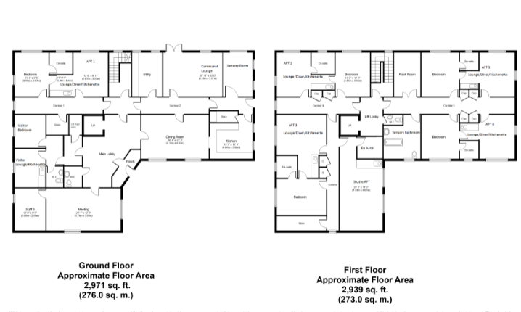
Property specification
High specification, robust service, low arousal
Six single apartments – lounge/ diner, bedroom, en suite wet room, low arousal
Private and large shared garden with sensory features
Communal space – lounge, dining area, kitchen, sensory spaces, laundry
Staff offices and meeting rooms
Assistive technology
Large car park

Slide 12

Service Model
Meeting needs of those with ongoing challenging behaviours and risks
Small with low numbers of service users -Registering the Right Support
Own apartment to ensure as ordinary living setting as possible
High staffing ratios
A focus on positive behavioural support, where
every service user has a positive behaviour support
plan working dynamically to support them.
Staff trained in TMVA equips them to manage
violence, aggression or other challenging behaviour.

Slide 13

Delivered in capable environments and staffing where individuals may display changing levels of behaviour that pose a risk to themselves or others, but can be managed safely.
Care and support is tailored to the individual developed in partnership with the Service User, their MDT, family/carer and ICATT/other health professionals.
Care is offered in the least restrictive way providing appropriate Deprivation of Liberty safeguards.
Communication plans are in place to support effective communication.
Health needs are met in line with the person’s Health Action Plan, Hospital passports and actions taken to reduce premature mortality.
Transport is provided which enables the individual to access
daytime activities and foster or maintain personal
relationships and use of public transport,
encouraged.

Slide 14

Bespoking the service
Assessments at early stage – prior to build
Replicating existing design / spec – hospitals
Replicating staffing ratios at least initially
Regular meetings with builders to adapt plans
Examples:
Washing machine in apartment to mitigate behaviours
Larger than normal panels in doors to be able to see staff
Private garden
Very sparse apartment

Slide 15
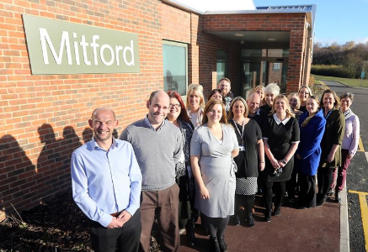
Transition
Effective collaborative communication
Training from existing service provider
Work on a timescale that suits service user
Regular and consistent visits from a skilled staff team with specific goals for each visit
Staff Team and service user would work together to establish his needs and build a positive relationship
Include Family and Commissioners in the transition process
Elysium Staff Team to spend time with service users current team

Slide 16
Thank you, any questions?

